Slide 1

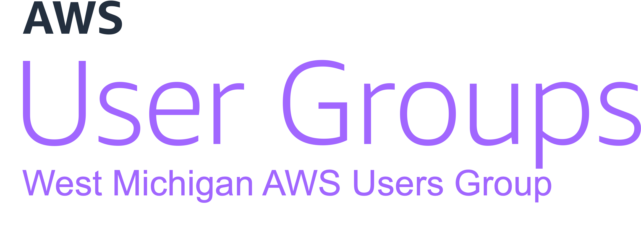

Automating Pull Requests with
CDK and Bedrock
March 2024

Slide 2



Introductions
Trent Nielsen
Justin Wheeler
wheeleruniverse
Enterprise Architect @ PXG
Cloud Consultant
Husband and Father
AWS User Group Leader
Senior Software Developer @ Bravo LT
12x AWS Certified
AWS Community Builder
AWS User Group Leader
Notes:
Use the abundance of AWS on this slide as a transition point

Slide 3
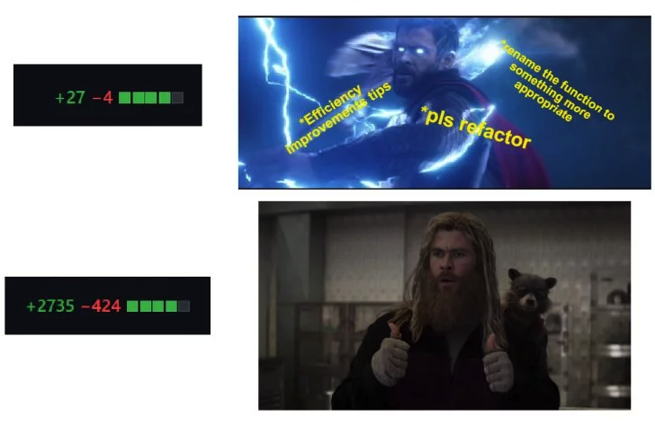

Slide 4
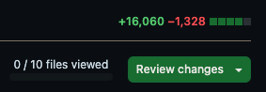
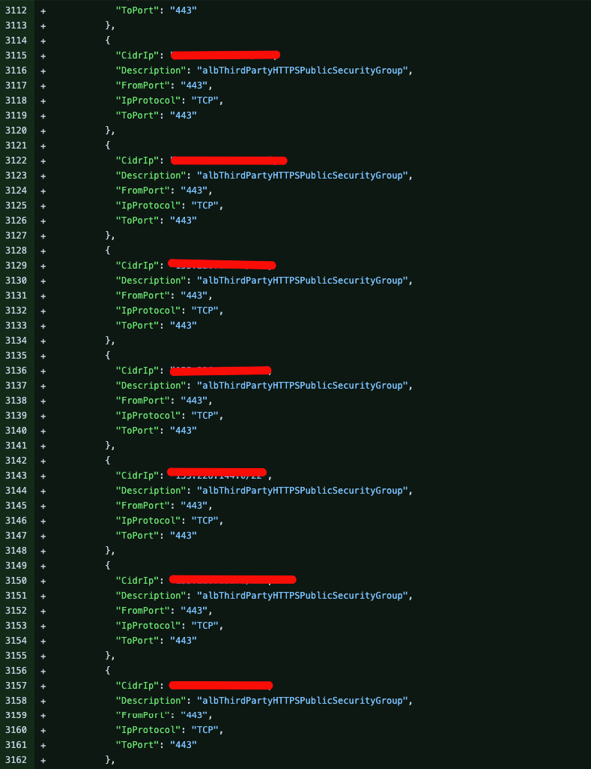
Look Familiar?

Slide 5
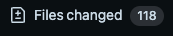
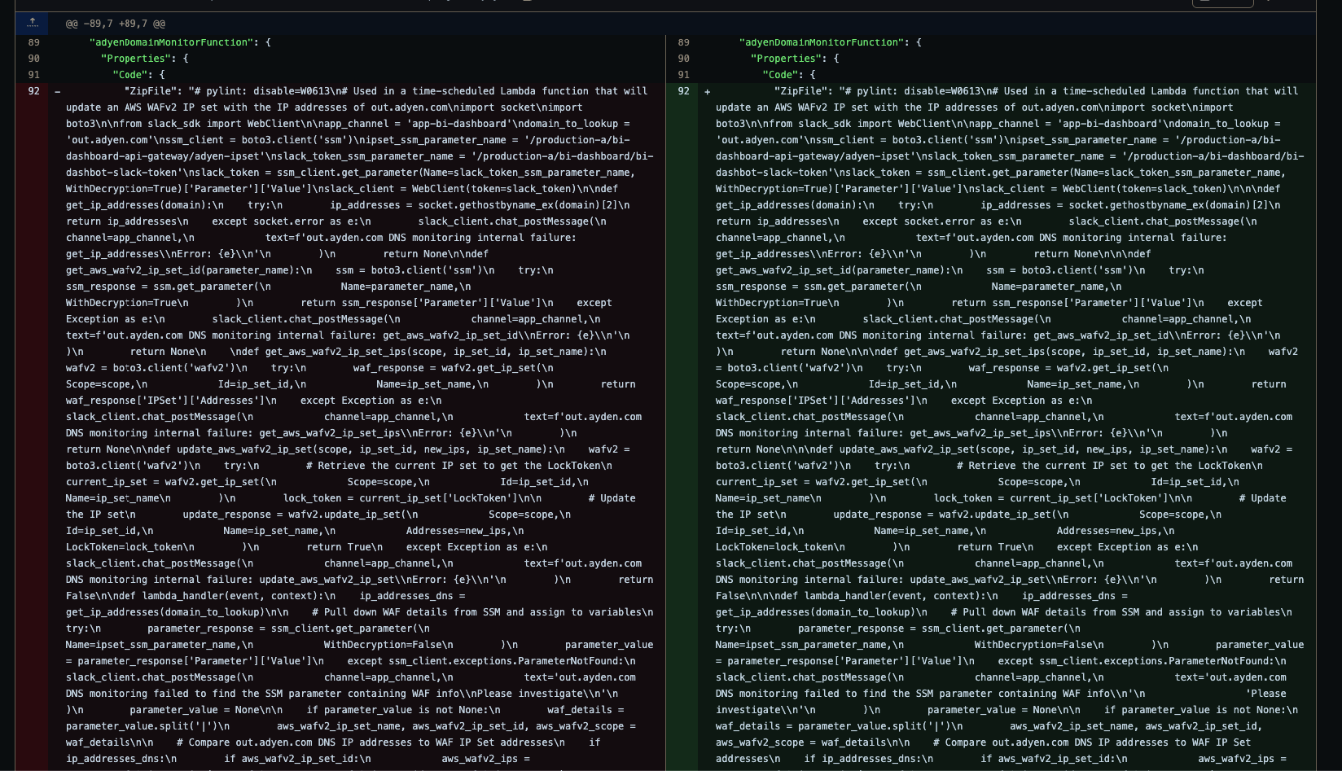
Look Familiar?

Slide 6
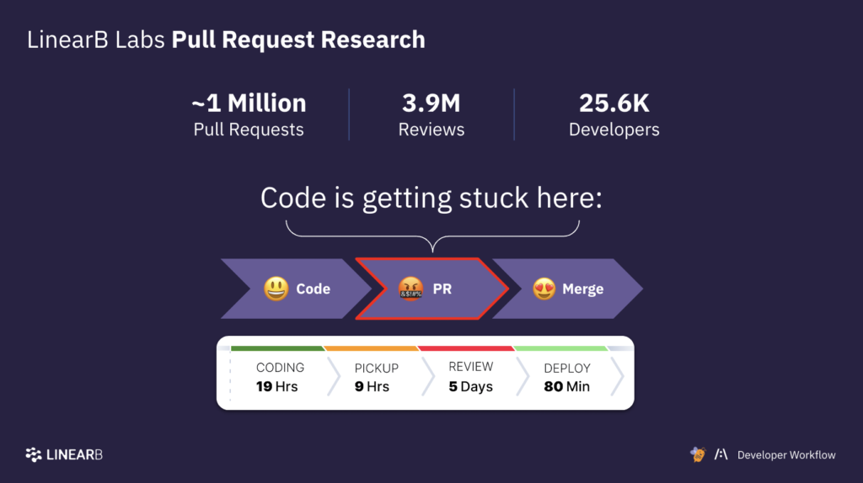
Notes:
Pull requests are the biggest bottleneck in software development
Large pull requests often don’t get the attention they need, which increases bugs
Giving feedback can be repetitive, tedious, and time consuming
Certain feedback can harm team morale e.g. whitespace, code formatting issues

Slide 7

Amazon Web Services
W
A
S
The most comprehensive cloud platform
With 200+ fully featured services
Functionality that would be hard to replicate
Purpose-built offerings
Every Action is an API calls
Supports 100% automation
Supports logging
Security at every layer
Notes:
The most comprehensive cloud platform
With 200+ fully featured services
Functionality that would be hard to replicate (retries, exponential backoff, dead letter queues, autoscaling, throttling, AWS service integrations)
Purpose-built offerings (in-memory, graph, time series, quantum)
Every Action is an API calls
Supports 100% automation
Security at every layer (1 click encryption, provided SSL certs, logging, network, firewall, secrets)

Slide 8
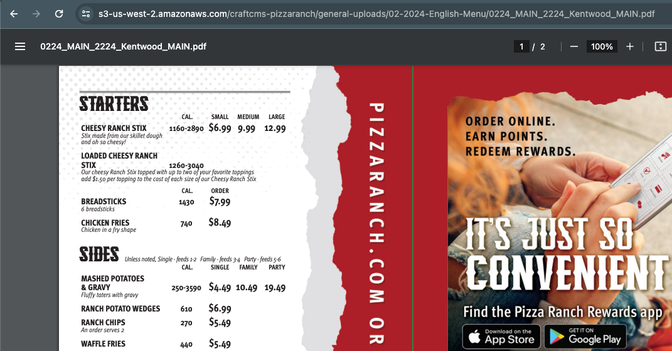
AWS in the Wild
Notes:
Pizza Ranch

Slide 9
AWS in the Wild

Slide 10




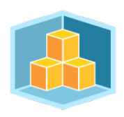


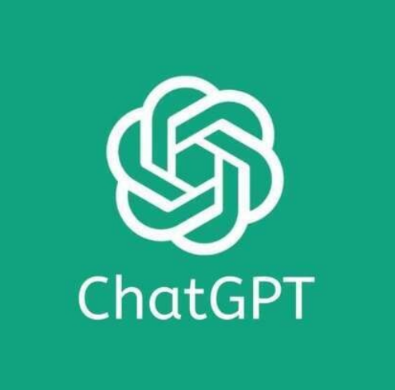
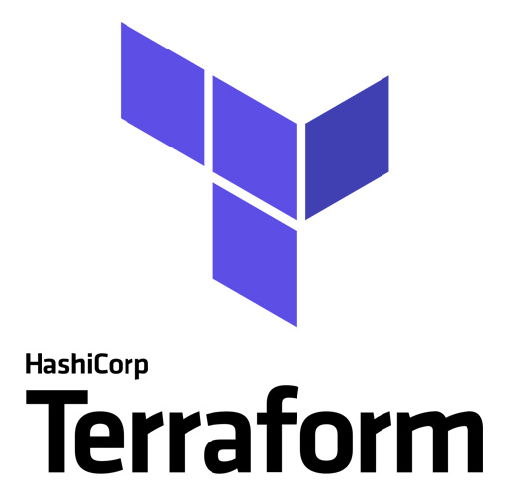

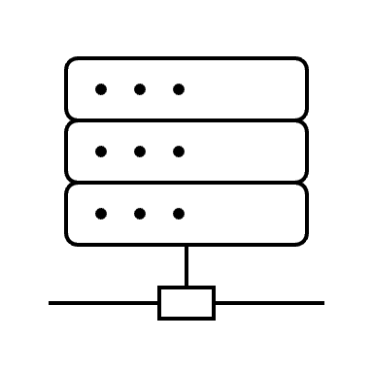
Key Services
Bedrock
Lambda
API Gateway
CloudFormation
CDK
Notes:
Bedrock: AWS version of ChatGPT with more bells and whistles (compare to ChatGPT)
Lambda: serverless compute option where you provide your code and a trigger like uploading an object or calling an API (compare to operations team)
API Gateway: front door for our application; the URL that GitHub will call with our webhook
CloudFormation: creates AWS infrastructure through the API calls I mentioned earlier with templates that are written in JSON or YAML
CDK: creates AWS infrastructure through programming languages that you already know like Python and TypeScript; delegates to CloudFormation to carry out changes

Slide 11

Solution
AI
Compute
API
Infrastructure
Automation
Notes:
Infrastructure Scaffolding through CDK
Automation through GitHub Actions
API with API Gateway
Compute through Lambda
AI with Bedrock

Slide 12
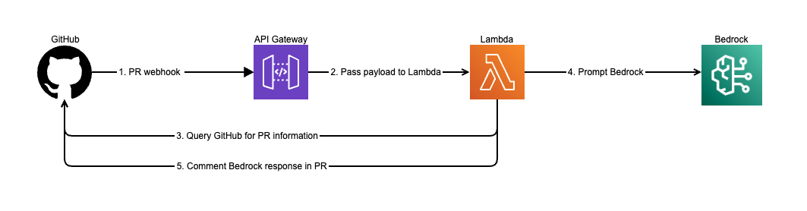
Architecture

Slide 13
API Gateway
Deep Dive

Slide 14
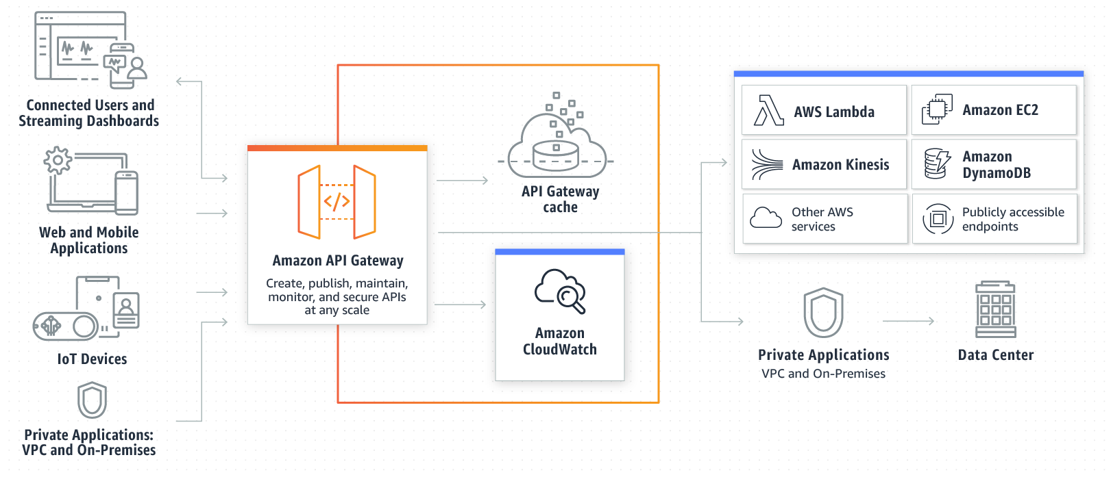
Why API Gateway?
Deployment
Authentication Options
Custom DNS
Validation
Transformation
… and more!
Notes:
Deployment: Blue/Green, Canary, Mock
Authentication Options: Custom API Keys, Identity Providers through Cognito, Custom Authorizers through Lambda
Custom DNS
Validation: Request/Response
Transformation: Request/Response
More: Caching, Logging, Rate Limiting, Throttling

Slide 15
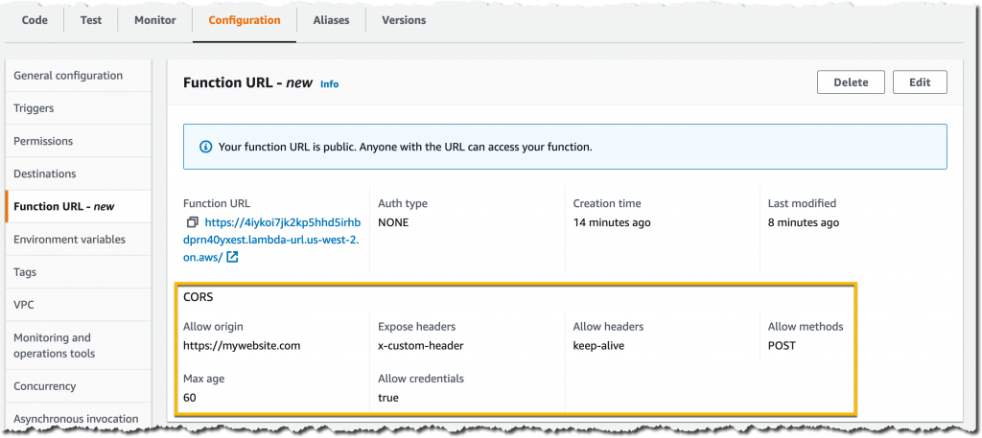
Lambda Function URL (Alternative)
Notes:
Since April 2022

Slide 16
CDK
Deep Dive

Slide 17
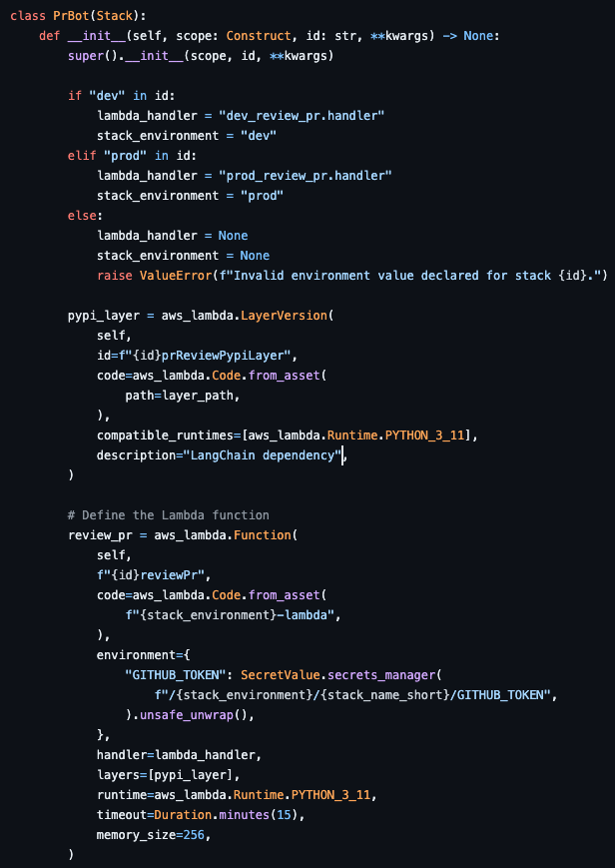
Why CDK?
Control
Organization
Reusability
Familiarity
Deployment
Support
Notes:
Control: if, for, while
Organization: code management
Reusability: shared code and libs
Familiarity: same programming languages, tools, and workflows – no Domain Specific Languages (DSL) like Terraform HashiCorp Configuration Language (HCL)
Deployment: 1-step deployment process as opposed to a 2-step, or multi-step deployment process
Support: Amazon provided support with plan

Slide 18

App Logging
API Gateway Access Logs
Lambda Execution Logs
Bedrock Prompt Logs
Notes:
API Gateway
Lambda
Bedrock

Slide 19
Bedrock
Claude Model access – must be requested in the console, no provisioned resources required.
Proposed solution used Claude 2.1

Slide 20
GitHub

Slide 21

More than just a code repo
Actions

Slide 22
Actions
Build Environment
CDK Synth
CDK Deploy
Notes:
Build Environment:
Install AWS-CDK and Python
Configure AWS Credentials
Build Assets
Layer
Lambda

Slide 23
More than just a code repo
Actions
Webhooks

Slide 24
Webhooks
Configured Per Repo
Event Triggers
Enabled for PrBot

Slide 25
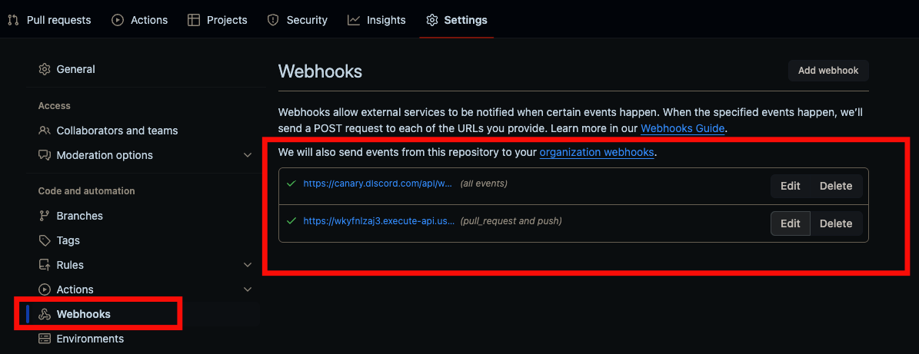

Slide 26
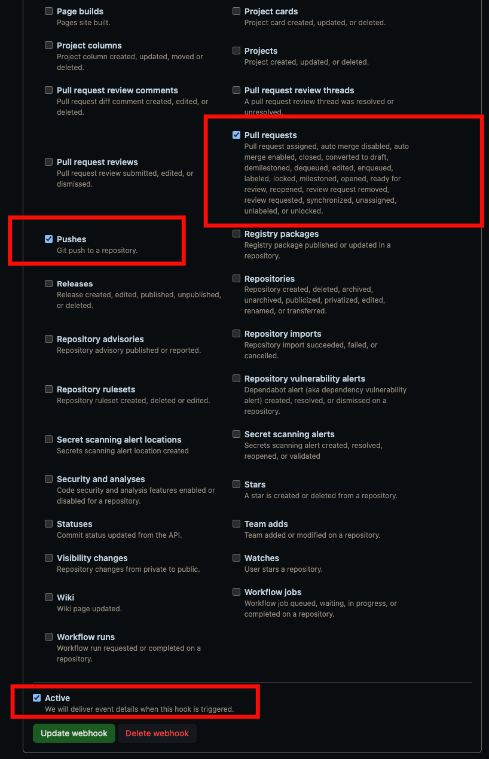
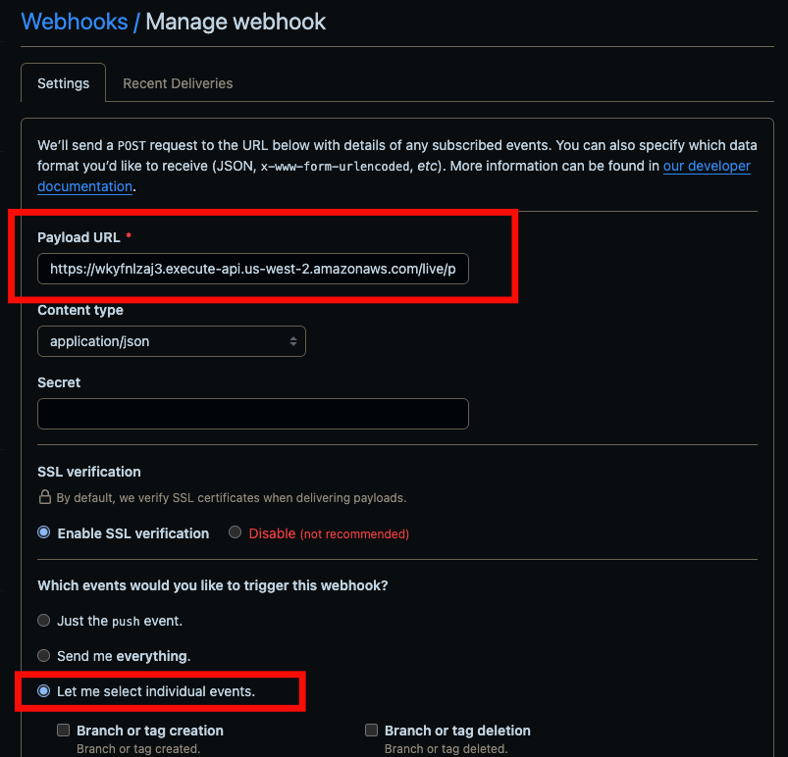

Slide 27
More than just a code repo
Actions
Webhooks
Secrets

Slide 28

Secrets
Deploy user
Github Token

Slide 29
CI Secrets
Service Account Keys
Configured in GitHub
Notes:
Service Account Keys: provides deploy keys for Actions

Slide 30
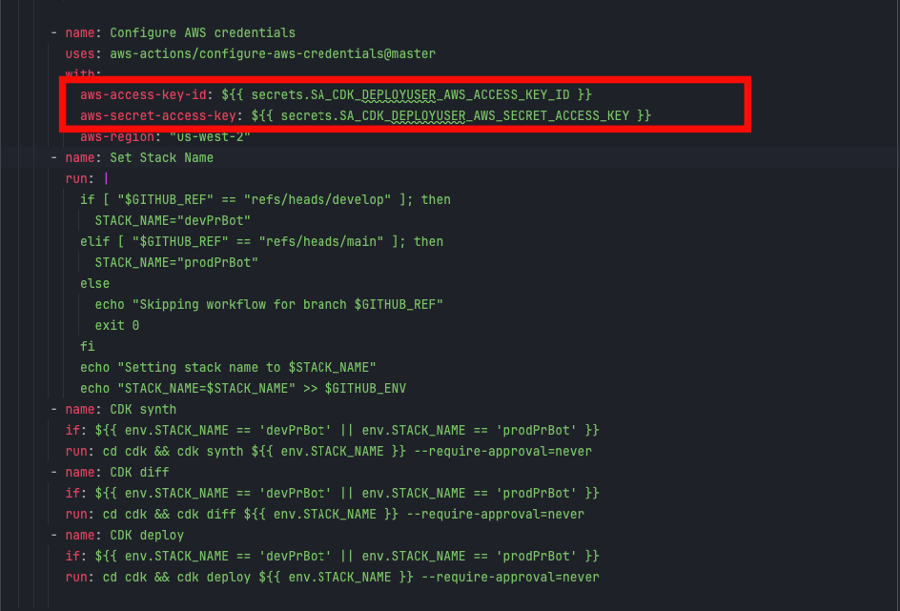
CI Secrets

Slide 31
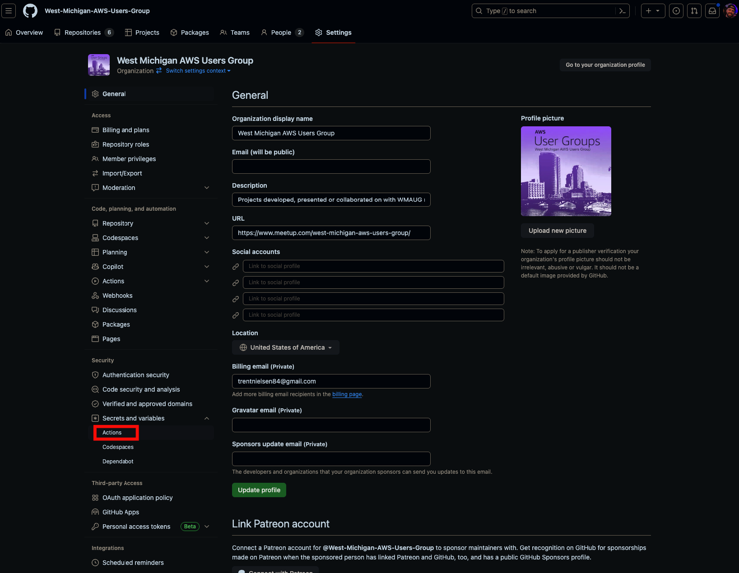

Slide 33
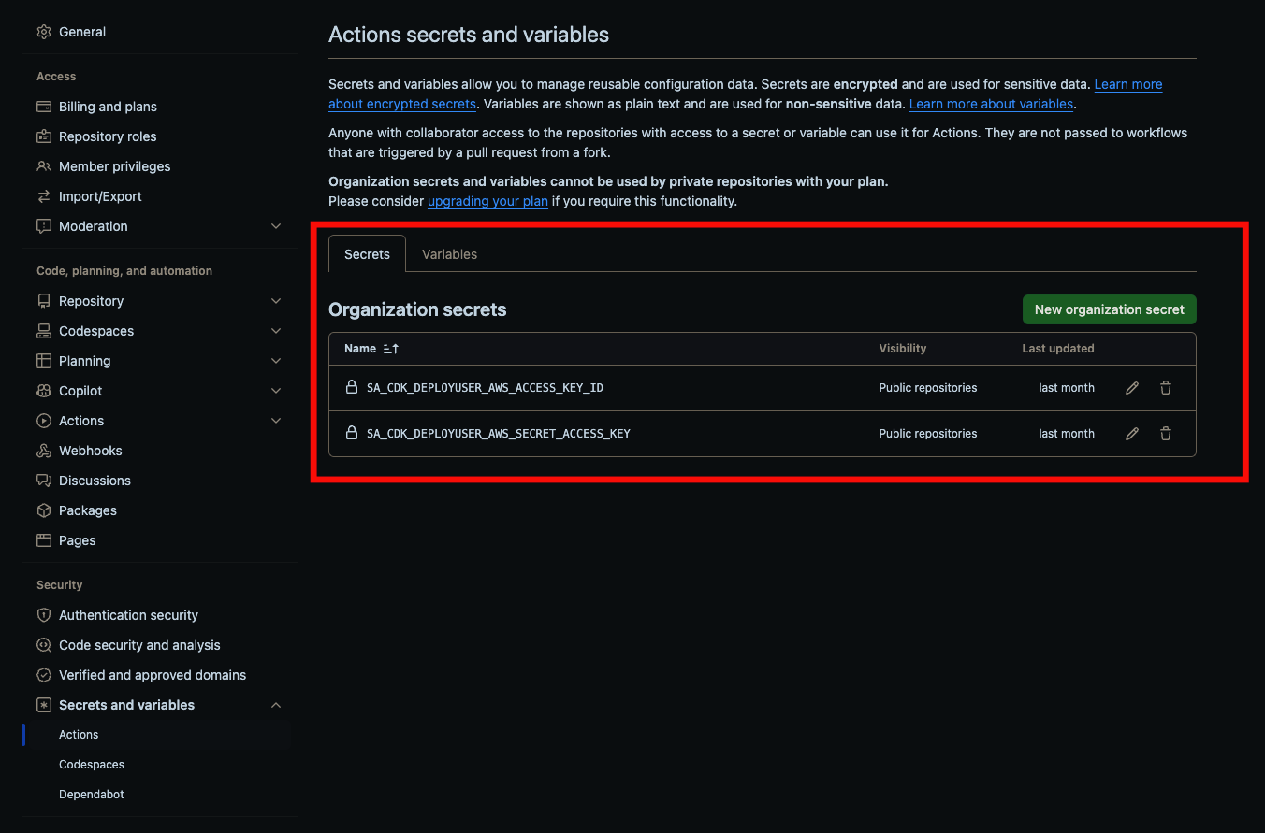
Secrets

Slide 34
App Secrets
AWS Secrets
Code Reference

Slide 35
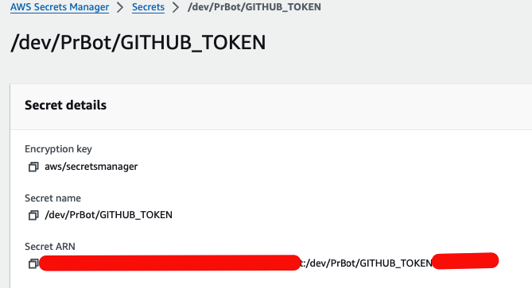
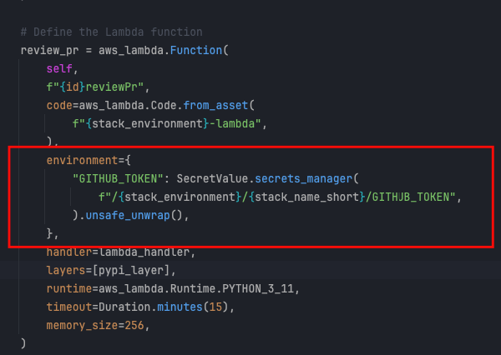
App Secrets

Slide 36
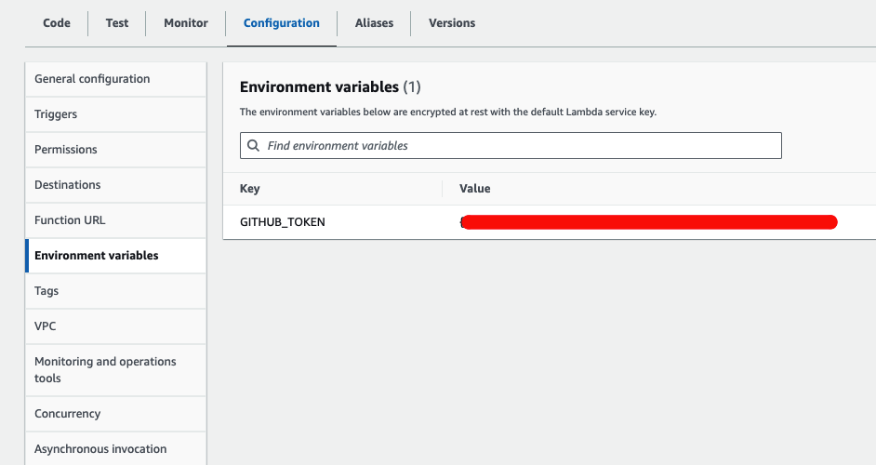
Secrets (Unsafely Unwrapped)

Slide 37
Actions Config
Review
Notes:
DEMO GitHub

Slide 38

Lambda + Bedrock Code Review

Slide 39
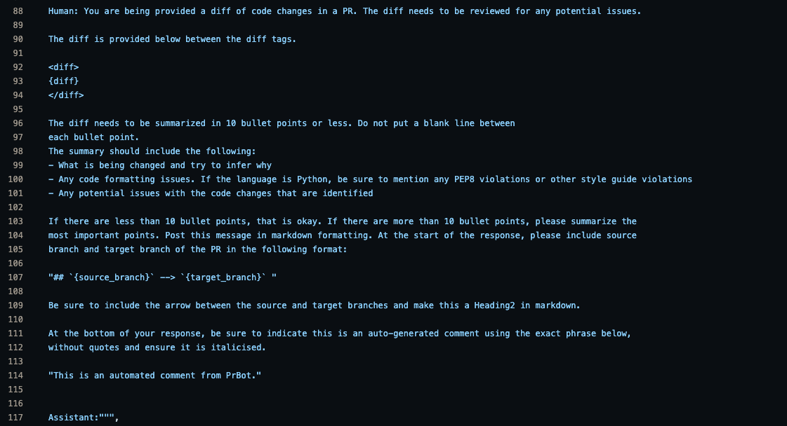
Prompt

Slide 40
Examples

Slide 41
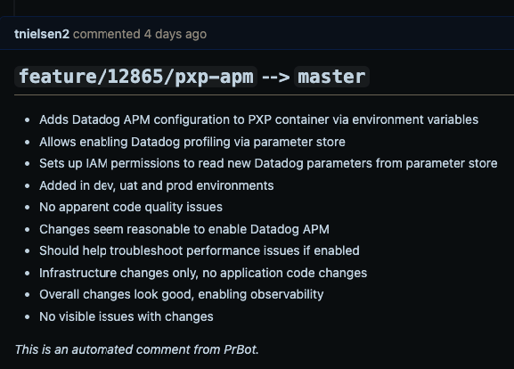
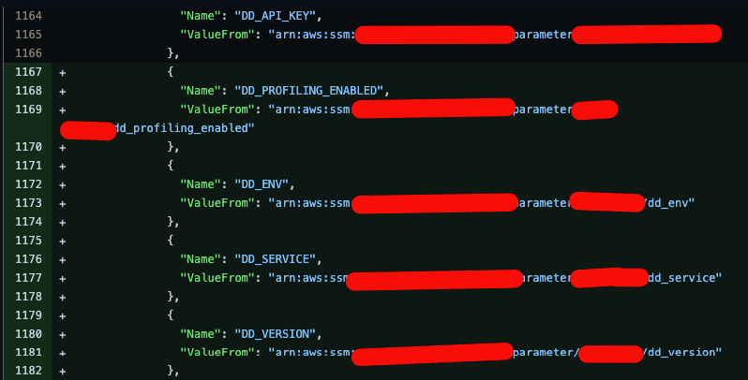
New Environment Variables

Slide 42
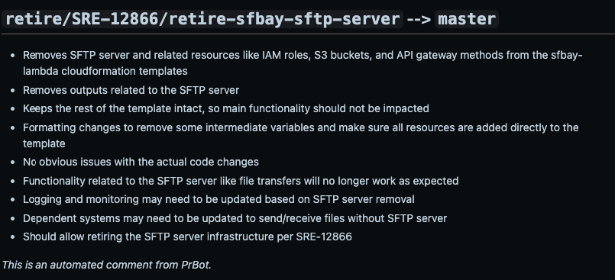
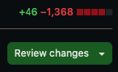
Stack Retirement

Slide 43
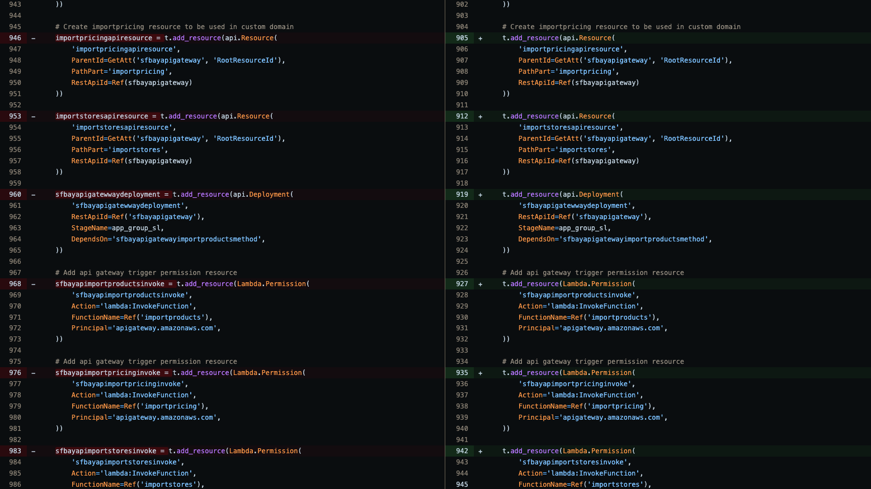
Stack Retirement (Continued)

Slide 44
Cost

Slide 45
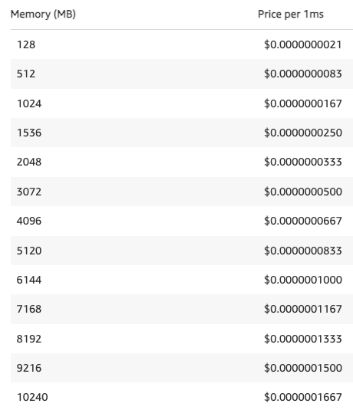
Freebies
256
2,000 mins/month
GitHub Actions
CDK
1,000,000 requests/month
400,000 GB-secs of compute/month
Lambda
CloudFormation
Notes:
GitHub Actions
Usage above free limits can be calculated with GitHub pricing calculator
CDK:
Does not incur any additional charges.
Delegates to CloudFormation.
CloudFormation
Only pay for what you provision.
Lambda
Spread across all functions.
1024 would be 400,000 seconds
2048 would be 200,000 seconds
512 would be 800,000 seconds (alternatively)
256 is what we’re currently using and would equate to 1.6 M seconds per month

Slide 46
Billed Services
$1.00/1,000,000 requests
$0.008/1,000 input tokens
$0.024/1,000 output tokens
API Gateway (http)
Bedrock
(Claude 2.1)
$0.20/1,000,000 requests
$0.0000166667/GB-sec of compute
Lambda
(x86)
US East (N. Virginia) as of 2024-03-07

Slide 47
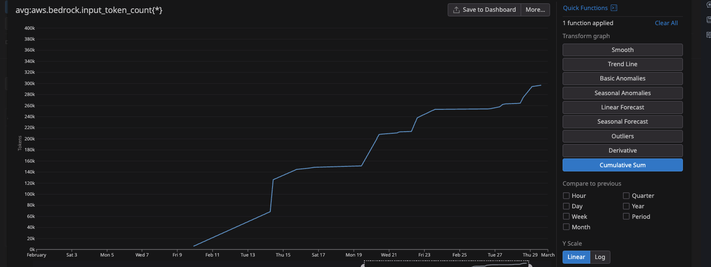
Usage

Slide 48
Usage

Slide 49
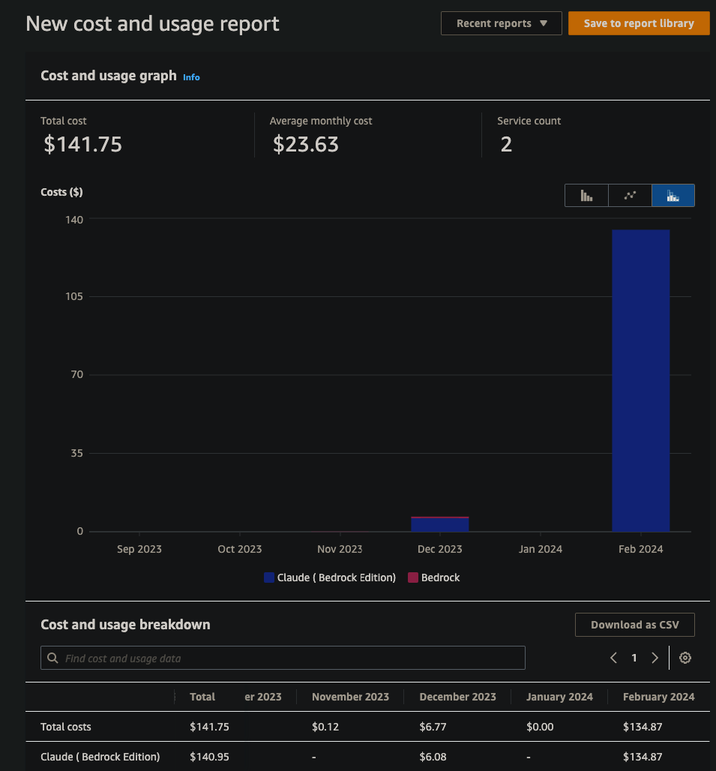
The Bottom Line

Slide 51
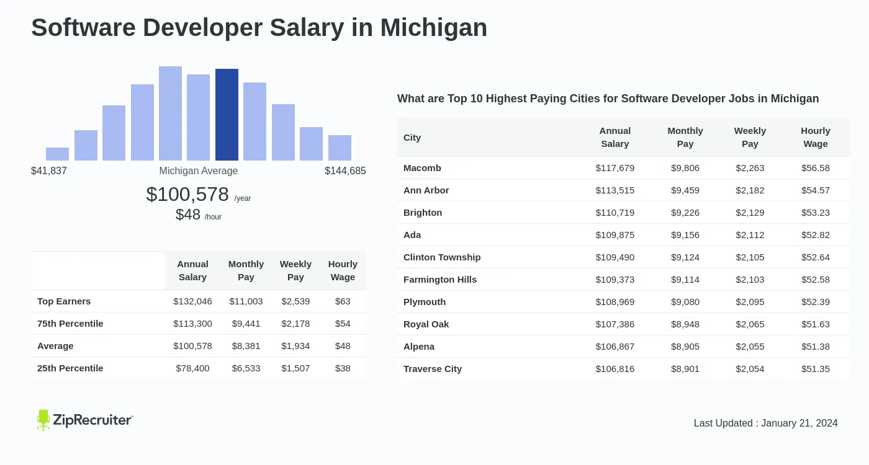
Total Cost of Ownership (TCO)
Include the time saved that is spent elsewhere

Slide 52
Total Cost of Ownership (TCO)
1 hour/day
5 hours/week
5/40 = 0.125 = 12.5%
$78,400/year
$78,400 * 0.125 = $9,800/year
$135 * 12 (months) = $1,620/year
Notes:
Top Earners: $16,500/year

Slide 53
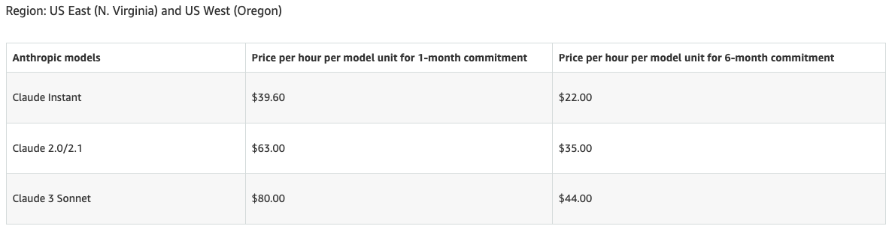
Cost Optimization
Fail Fast
Skip Irrelevant
File Filter
Manual Trigger (I am ready button)
Provisioned Throughput
Notes:
Fail Fast: prettier, lint, tests, sonar, etc.
Skip Irrelevant: 1-line changes, blacklist/whitelist, draft, and WIP
File Filter: blacklist/whitelist file extensions
Manual Trigger
Provisioned Throughput: Claude for multiple workloads

Slide 54
Improvements
AWS User Groups
54

Slide 55
Layer
Layer build process and version pinning
Tests
Implement CDK Tests
Permissions
Migrate to Service Account
Triggers
On demand w/ label usage
Update
Fetch Secrets instead of Environment Variables
Automation
Auto-tagging after Approvals
Notes:
Layer
Unique per environment for future testing
Pin to known good versions to prevent unexpected layer changes
Automation
2x auto-reviewer tagging

Slide 56
User Group Updates
New Organizer
2024 Schedule
User Group AWS Accounts
AWS Credits Raffle

Slide 57

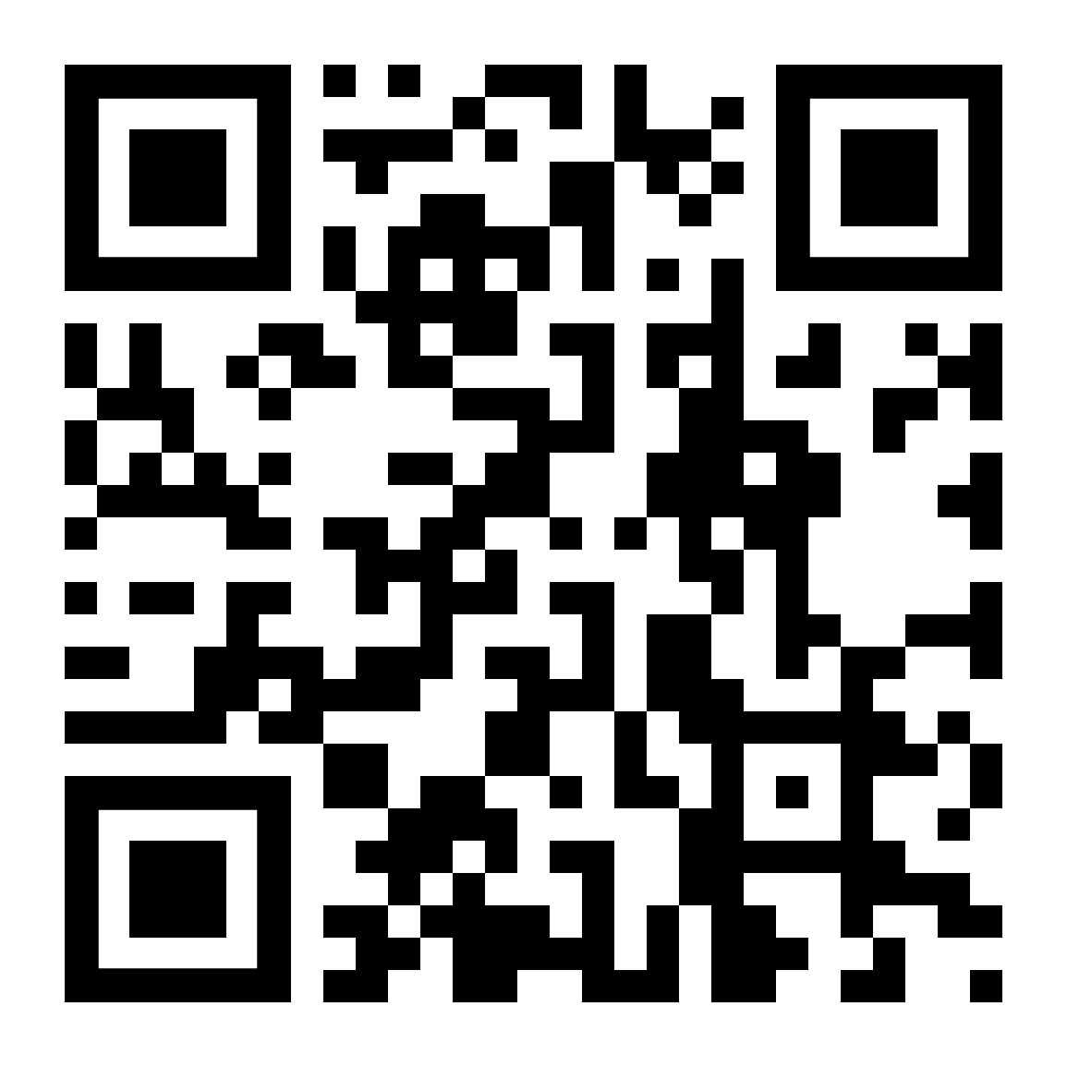
Current
PrBot
Upcoming
Betrayal Buddy
WMAUG Website
WMAUG AWS Account Rollout

Slide 58
Raffle
import random def print_random(values): index = random.randint(0, len(values) - 1) selected = values[index]
print(f”Winner: {selected}")
print_random(["Trent", "Justin", "Darth", "Luke", "Chewy”])

Slide 59

AWS User Groups
59
Notes:
Take Questions

